Slide 1
Lab - Mashups

Slide 2
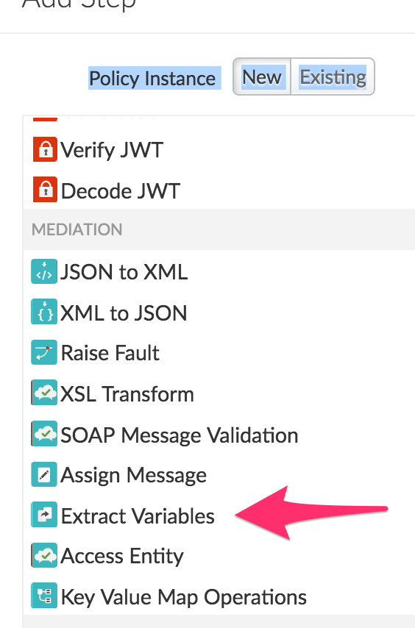
Mashup the /stores + Geocode API response
Create a new Extract Variables policy
Specify the JSON path to the address attribute to extract its value

Slide 3
ExtractStoreAddress policy
Replace the policy xml with the xml below:
<?xml version="1.0" encoding="UTF-8" standalone="yes"?> <ExtractVariables async="false" continueOnError="false" enabled="true" name="ExtractVariables-Formatted-Address"> <DisplayName>ExtractVariables-Formatted-Address</DisplayName> <Properties/> <IgnoreUnresolvedVariables>true</IgnoreUnresolvedVariables> <JSONPayload> <Variable name="address"> <JSONPath>$.results[0].formatted_address</JSONPath> </Variable> </JSONPayload> <Source clearPayload="false">calloutResponse.content</Source> </ExtractVariables>

Slide 4
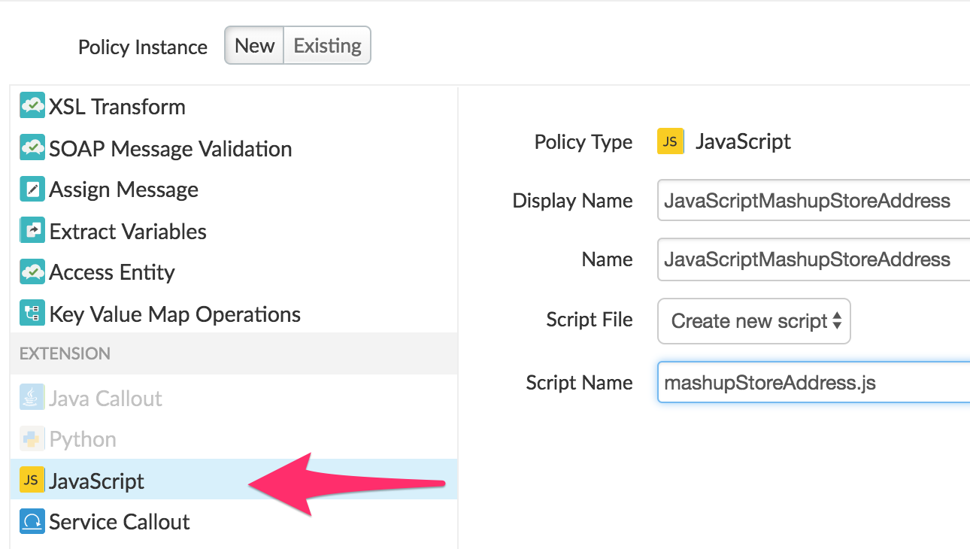
Add a Javascript policy to mashup the response
Create a new Javascript policy

Slide 5
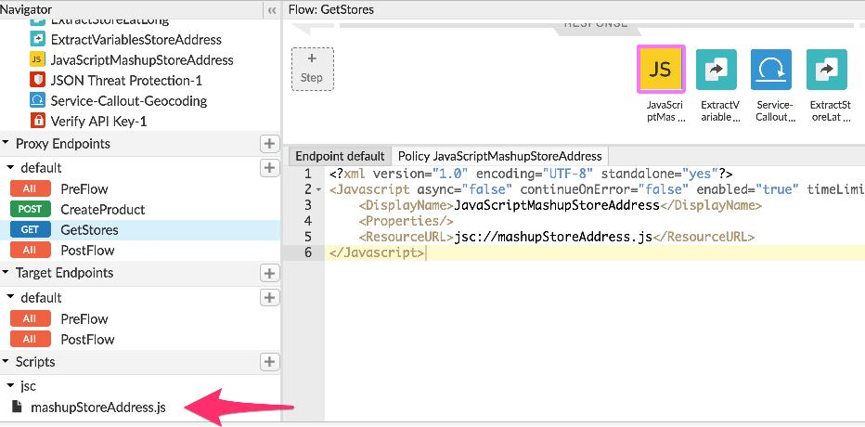
Javascript policy

Slide 6
Javascript code for Mashup
var address = context.getVariable('address'); var responsePayload = JSON.parse(context.getVariable('response.content')); try{ responsePayload.entities[0].address = address; context.setVariable('response.content', JSON.stringify(responsePayload)); context.setVariable('mashupAddressSuccess', true); } catch(e){ print('Error occurred when trying to add the address to the response.'); context.setVariable('mashupAddressSuccess', false); }
The mashupAddressSuccess variable can be used in the flow to raise a fault if needed.

Slide 7
Test
Call the /stores/{storename} endpoint
Verify the response contains the store details alongwith the address of the store in the json payload

Slide 8
THANK YOU

